Slide 1
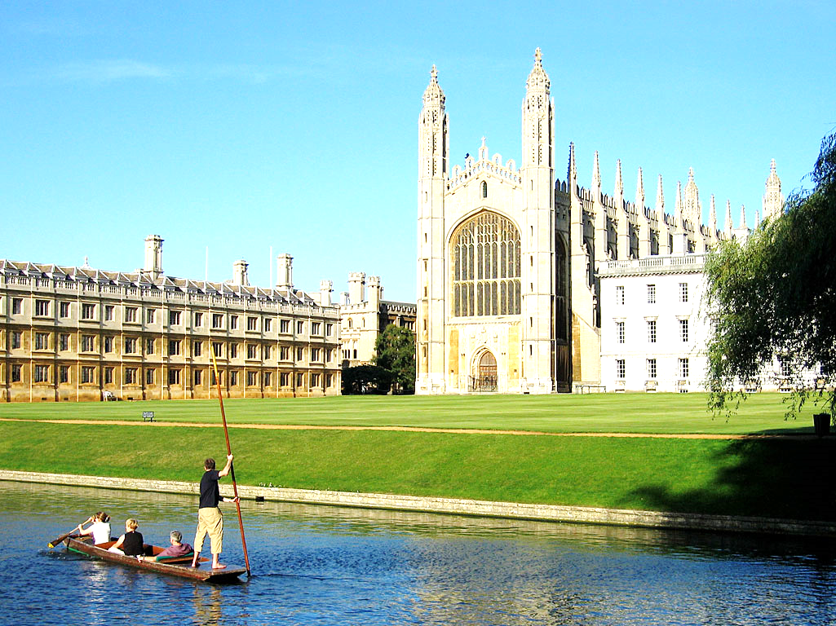

Professor David Cope
Foundation Fellow
Clare Hall
University of Cambridge

Slide 2
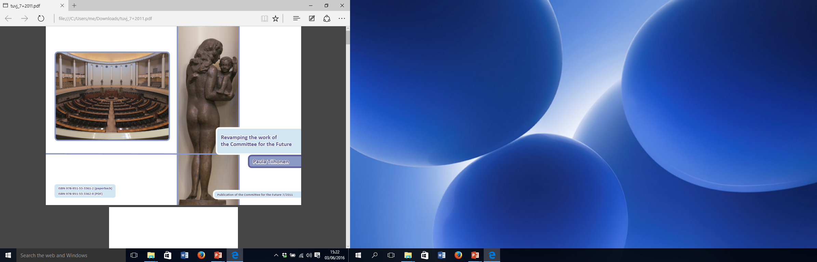
Statue of “Future” in the plenary chamber of Eduskunta, by Wäinö Aaltonen. It is the central of five statues that face members of the Finnish parliament in the chamber.
Responsibility TO
And Responsibility FOR
The Future

Slide 3
Responsibility TO: Facilitative
Responsibility FOR: Normative

Slide 5


Slide 6
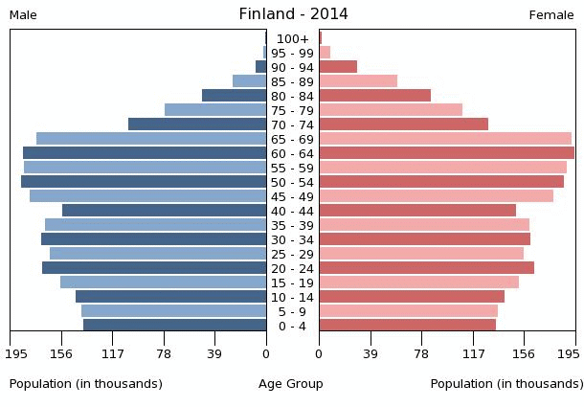

Slide 7
UK – Adults - % of Total Population’s “Years of Life Experience” in Five Year Age Groups, 2011

Slide 8
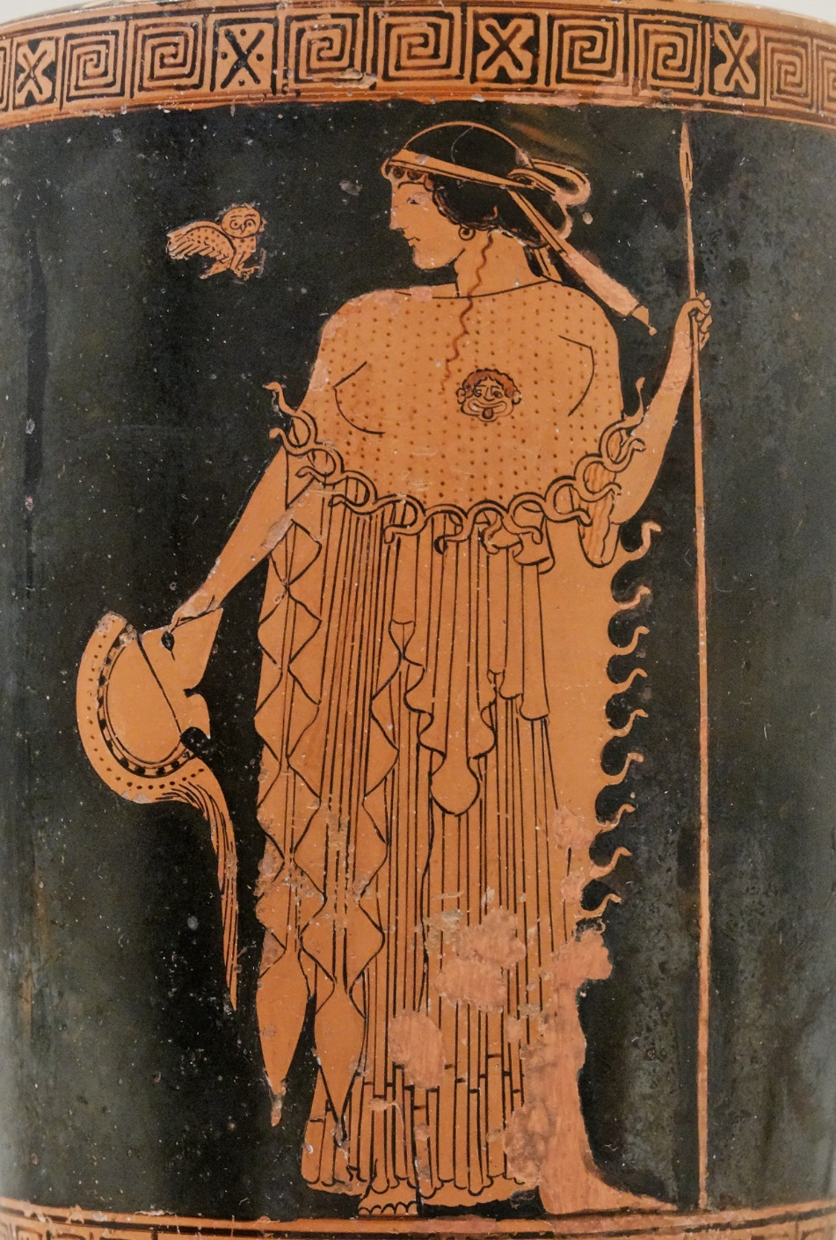
The owl of Minerva takes its flight only when the shades of night are gathering.
G.W.F. Hegel, Philosophy of Right (1820)

Slide 9
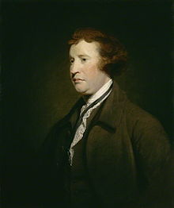
Edmund Burke 1729-1797

Slide 10

Thanks for Listening!

